Slide 1

WAY TO ENTERPRISE
AWS
VTI ACADEMY
Author: duy.nguyenngoc1@vti.com.vn

Slide 2
Agenda
Elastic Container Service
Elastic Container Registry Service
Elastic Kubernetes Service
CodePipeline Service
Copyright © VTI Academy All Rights Reserved

Slide 3
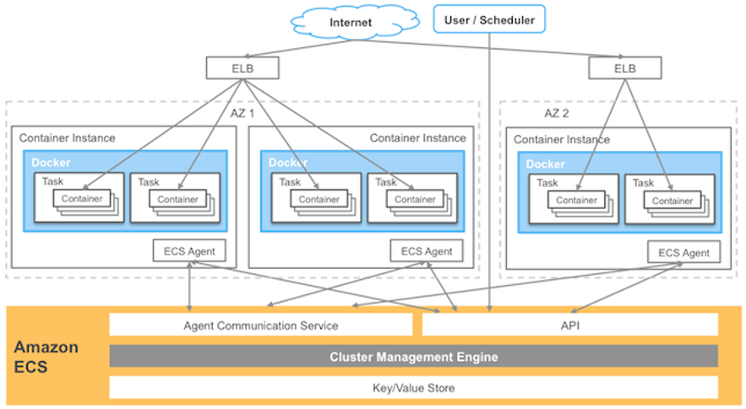
Elastic Container Service
Is service that allows manage containers running on AWS (Similar to Docker Swarm, Kubernetes)
You must provision & maintain EC2 instances / Fargate (Serverless)
Integrated with other AWS Services (ELB, Auto Scaling, SQS, ...)
Usecases: microservices, batch job
Price: https://aws.amazon.com/ecs/pricing
Tutorial: https://docs.aws.amazon.com/AmazonECS/latest/developerguide/Welcome.html

Slide 4
Elastic Container Service
Demo
  https://www.youtube.com/watch?v=oyWOkGPgaM0

Slide 5
Assignment
  Self-practice

Slide 6
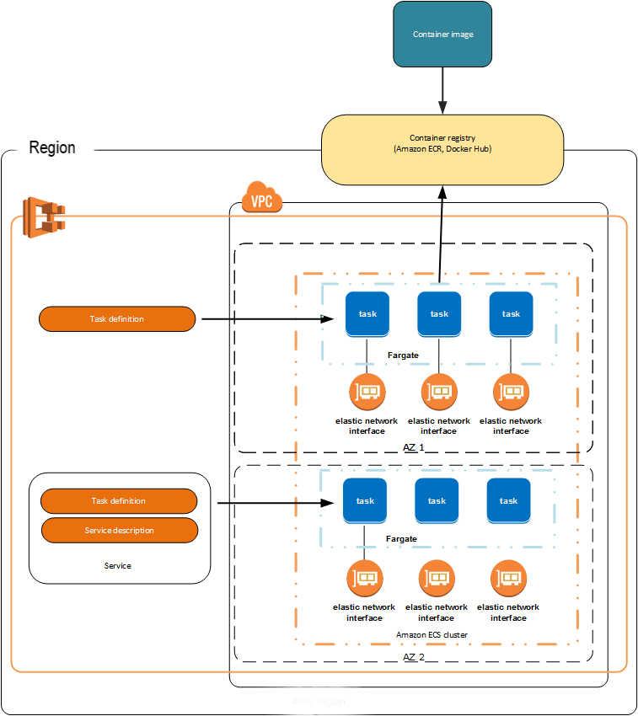
Elastic Container Service
Components
  Registry
  Image/Container
  Instance
  Task Definition / Task / Scheduling Task
  Service
  Cluster

Slide 7
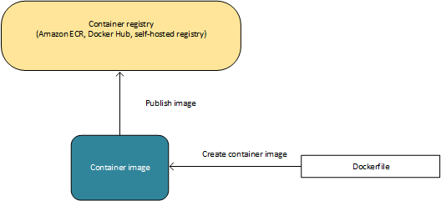
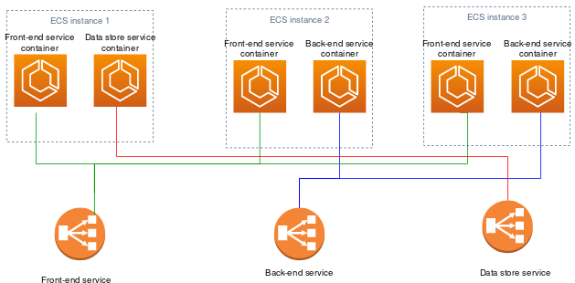
Elastic Container Service
  Registry
    A place to save images
    Ex: Elastic Container Registry (ECR), Docker Hub
  Image/Container: Similar to Docker
  Instance
    Run the containers
    3 types
      EC2 instance: on-demand / spot / reserved instance
Image/Container
Instances

Slide 8
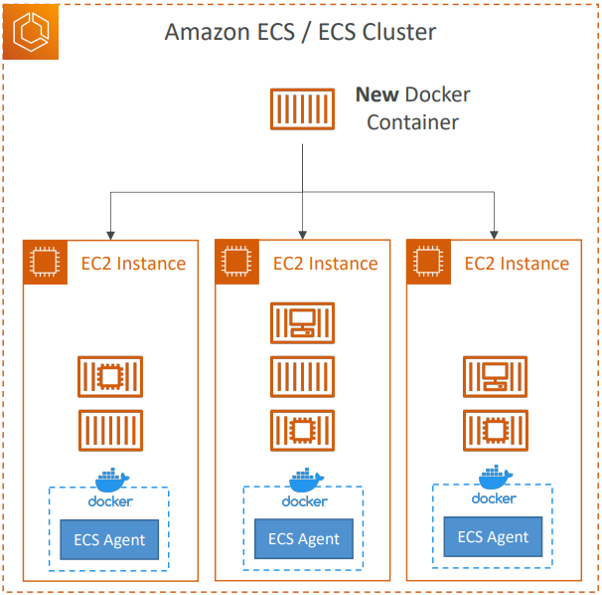
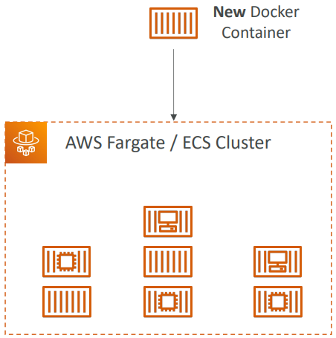
Elastic Container Service
      External instance: on-premises server, virtual machine
      Fargate: Serverless, you do not provision the infrastructure (no EC2 instances to manage)
EC2 instance
AWS takes care of starting / stopping containers
Fargate
AWS just runs ECS Tasks for you based on the CPU / RAM you need

Slide 9
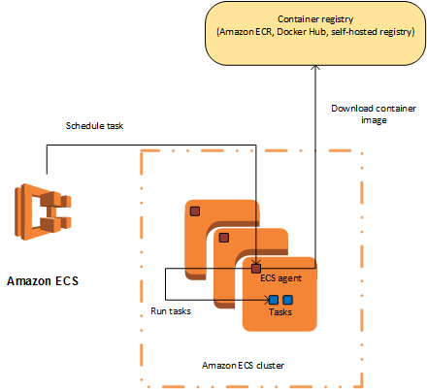
Elastic Container Service
    Installed Container Agent to send container information to ECS
Container Agent

Slide 10
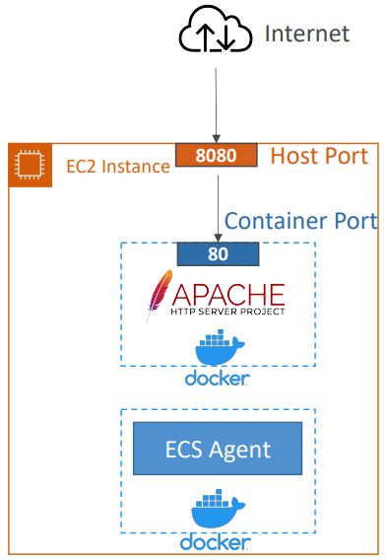
Elastic Container Service
  Task Definition
    JSON file, describe initialize container (up to 10 containers)
    Similar to docker compose
    Including:
      Task size: RAM, CPU, Volume (EFS, EBS, …), Network mode, …
      Container: Port, Image, Entry Point, Command, …, HealthCheck
      IAM Role, Log, ...
  Task: run multiple Task Definition in Cluster
  Scheduling Task: Run long-running task, scheduling task

Slide 11
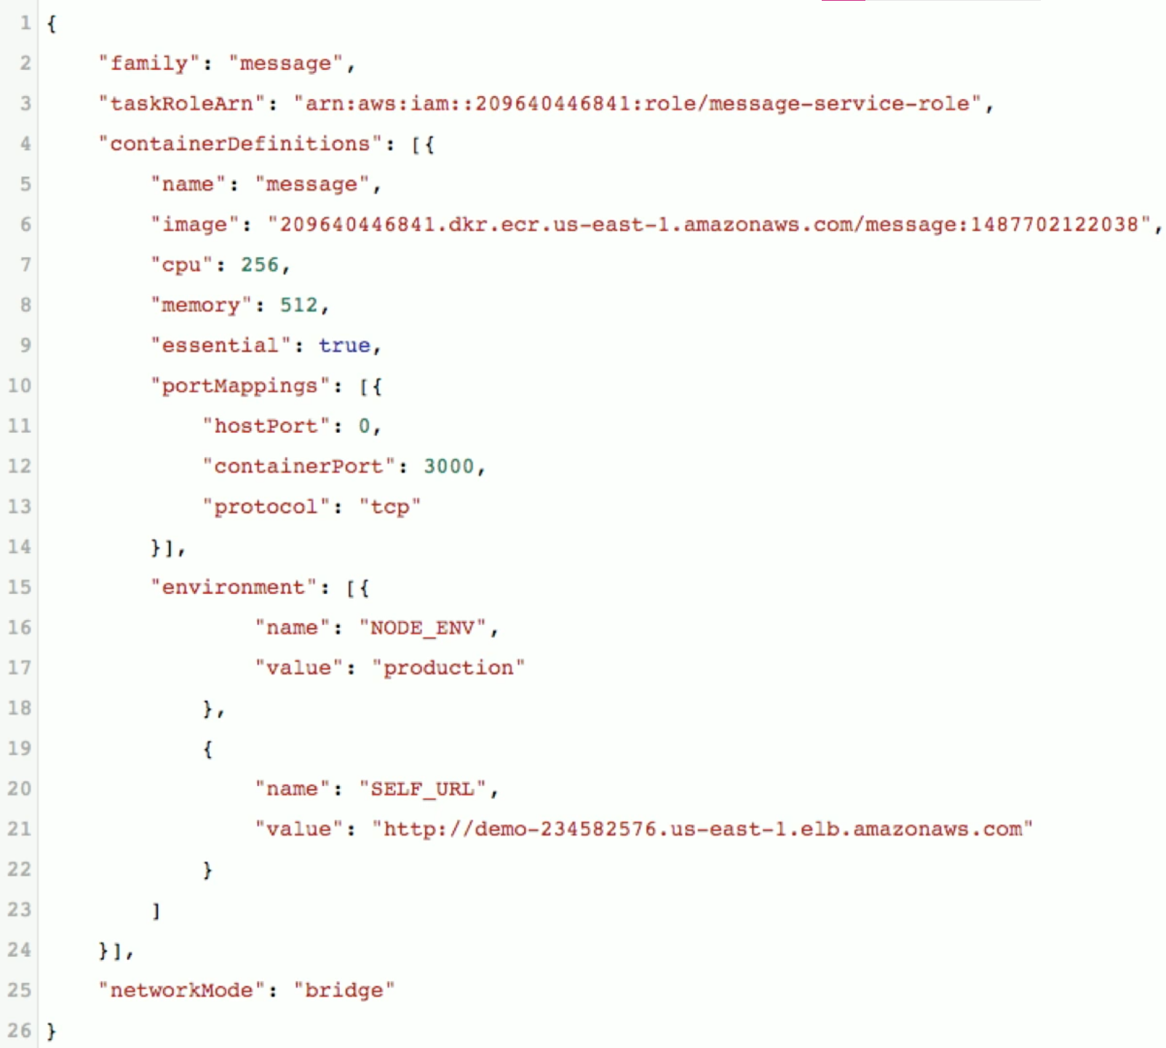
Elastic Container Service
  Service
    Define how many replicas of tasks in cluster
Task Tutorial

Slide 12
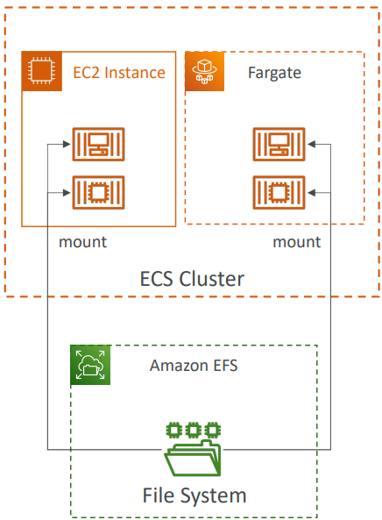
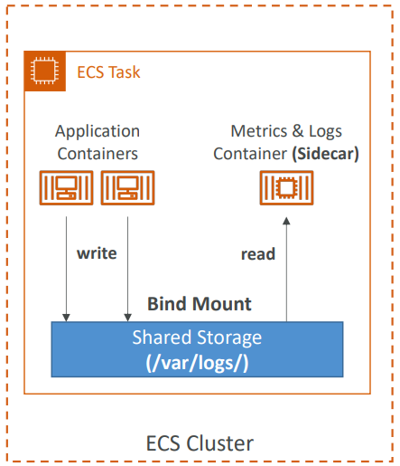
Elastic Container Service
    Support EFS for storing data, not support Fsx
    Bind mount for storing Instance Store
EFS
Bind mount

Slide 13
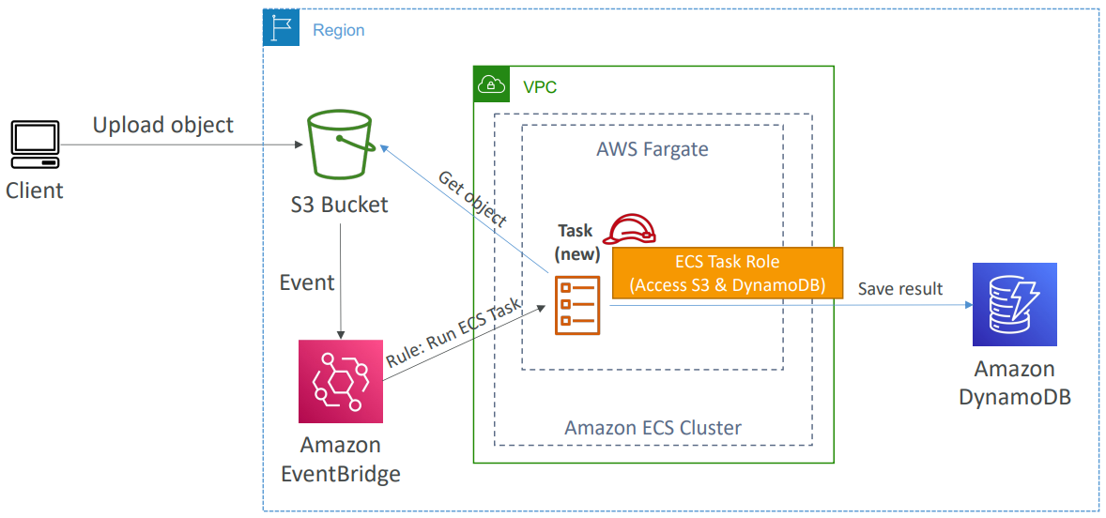
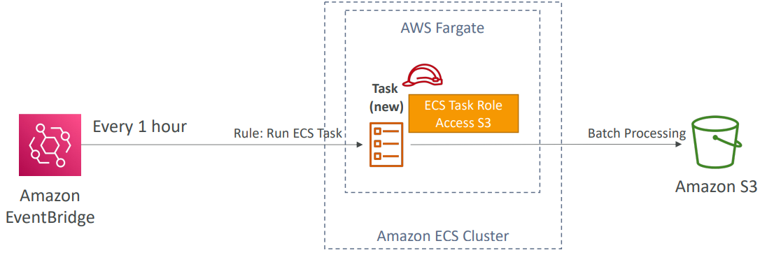
Elastic Container Service
    Call ECS Task through CloudWatch Event
CloudWatch Event (Event Bridge)
Event Schedule

Slide 14

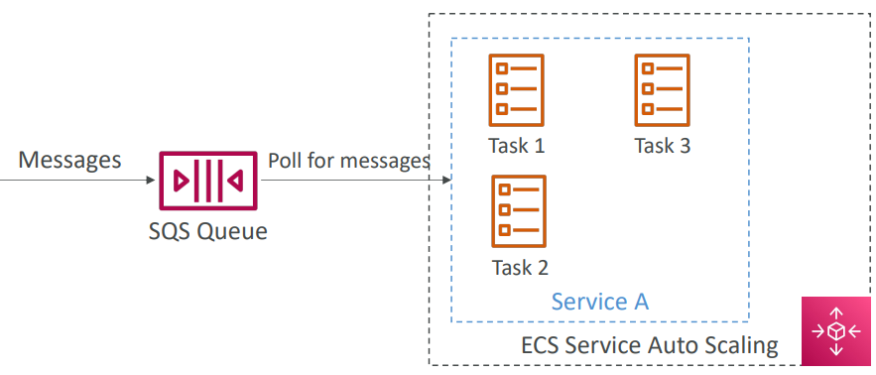
Elastic Container Service
    Call ECS Task pull message from SQS
    IAM Roles for ECS Task when calling to other AWS services
ECS Tasks - SQS
IAM Role for ECS Tasks

Slide 15
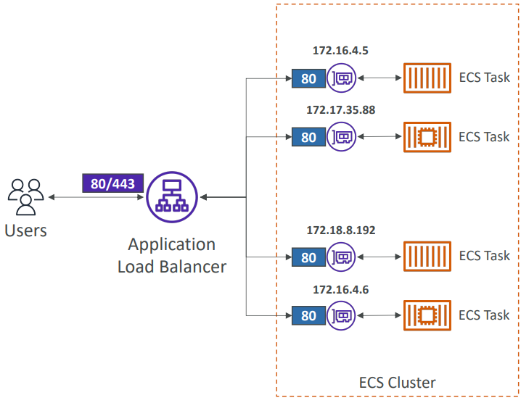
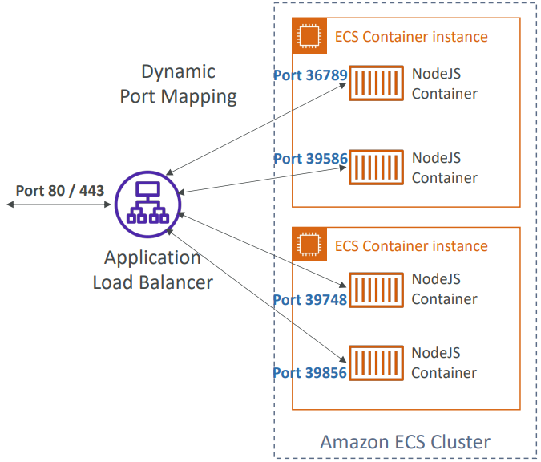
Elastic Container Service
    ELB, Health check
  Load Balancing with ECS (EC2 instance)
  Load Balancing with ECS (Fargate)

Slide 16
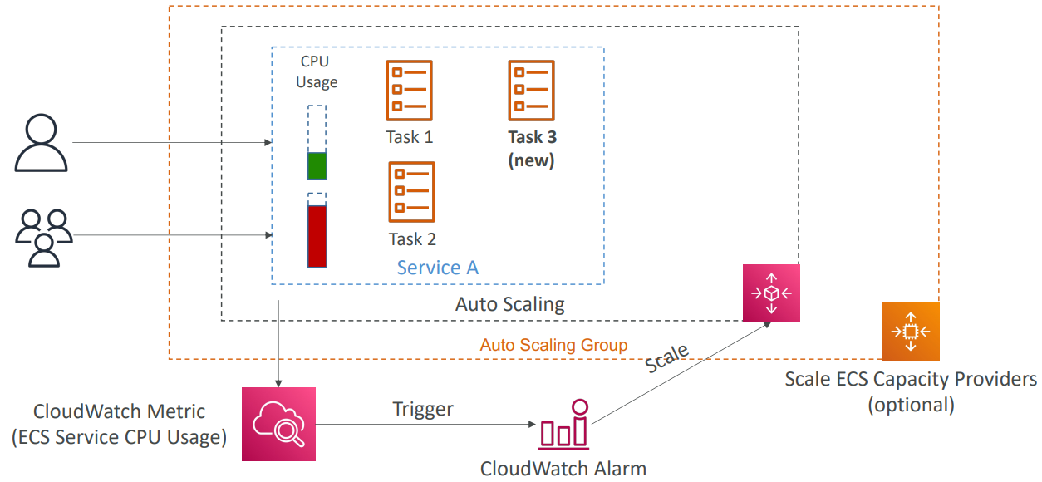
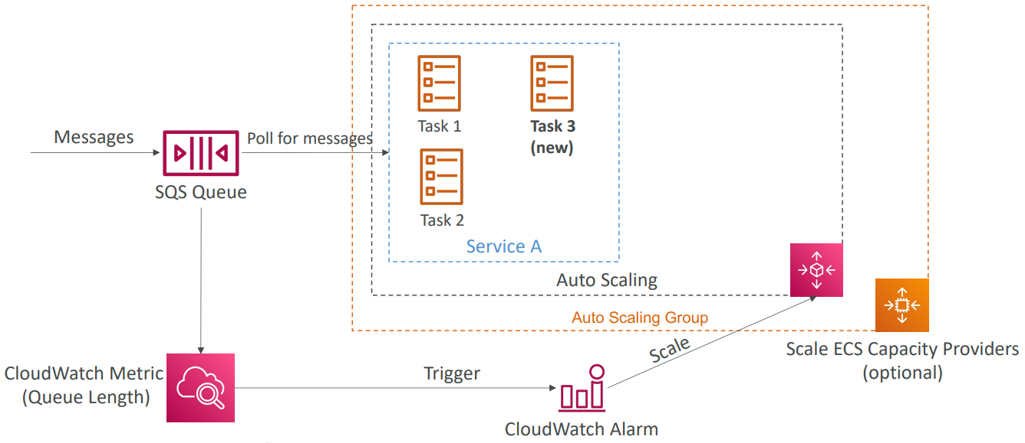
Elastic Container Service
    Auto Scaling
Auto Scaling
Automatically increase/decrease the desired number of ECS tasks based-on Ram, CPU, ALB Request Count
ECS Auto Scaling – SQS Queue based on message count

Slide 17
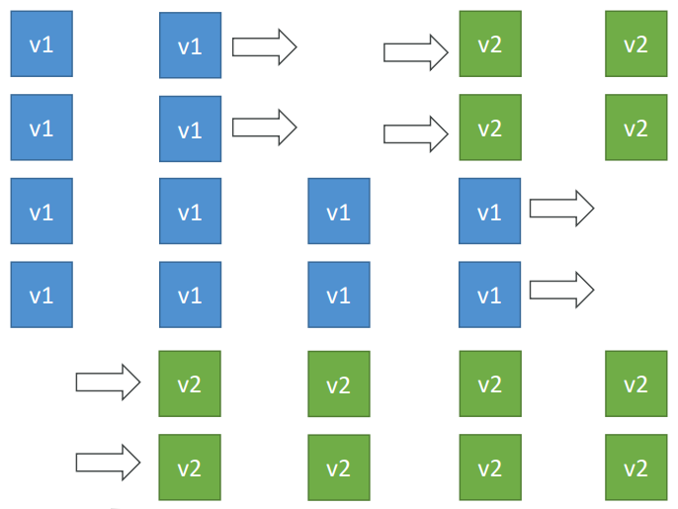
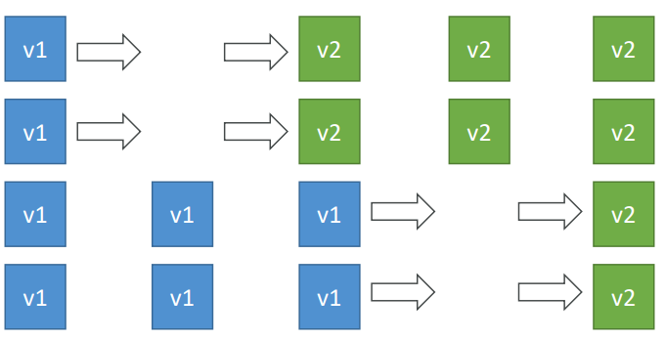
Elastic Container Service
    Rolling Update
      When updating from v1 to v2, we can control how many tasks can be started and stopped, and in which order
Min 50%, Max 100%
Min 100%, Max 150%

Slide 18
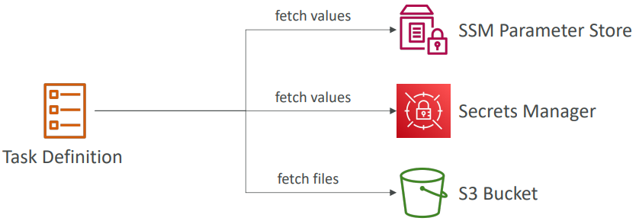
Elastic Container Service
    Environment Variable
      Support SSM Parameter Store Service & Secrets Manager Service
      Files - S3

Slide 19
Assignment
  Self-practice

Slide 20
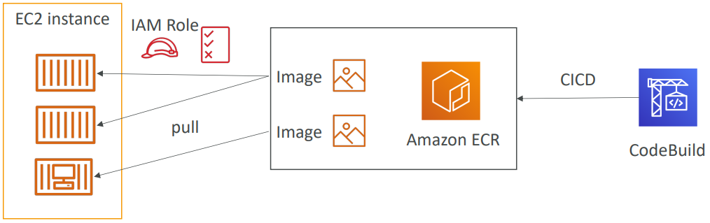
Elastic Container Registry Service
Store, manage and deploy containers on AWS, pay for what you use
Fully integrated with ECS & IAM for security, backed by S3
Supports image vulnerability scanning, version, tag, image lifecycle
Demo: https://www.youtube.com/watch?v=lvrdESP8Ffs

Slide 21
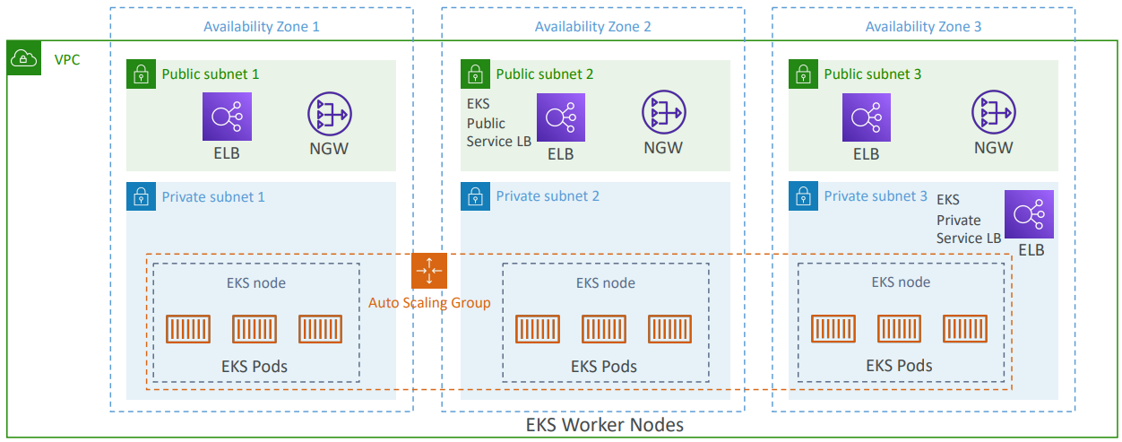
Elastic Kubernetes Service
Is service that allows manage kubernetes containers running on AWS
Open-source
Tutorial: https://docs.aws.amazon.com/eks/latest/userguide/getting-started.html

Slide 22
Elastic Kubernetes Service
It’s an alternative to ECS, similar goal but different API
Kubernetes is cloud-agnostic (can be used in any cloud – Azure, GCP…)
Supports EC2 (you want to to deploy worker nodes) or Fargate (deploy serverless containers)
Usecases
  Microservices, batch job
  If your company is already using Kubernetes on-premises or in another cloud, and wants to migrate to AWS using Kubernetes
Price: https://aws.amazon.com/eks/pricing

Slide 23
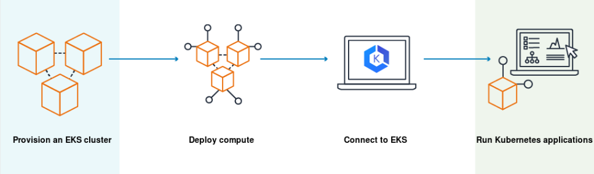
Elastic Kubernetes Service
Demo
  https://www.youtube.com/watch?v=O4h69KMm2tE

Slide 24
Assignment
  Self-practice

Slide 25
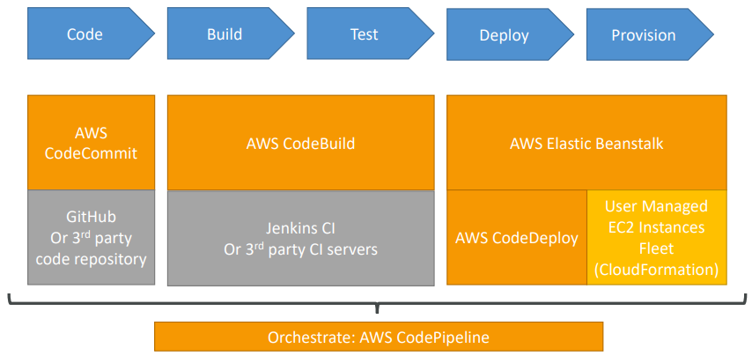
CodePipeline Service
Is service that allows deploy and release applications continuously and automatically
Usecases: microservices, automatically deploy
Price: https://aws.amazon.com/codepipeline/pricing
Tutorial: https://docs.aws.amazon.com/codepipeline/latest/userguide/welcome.html

Slide 26
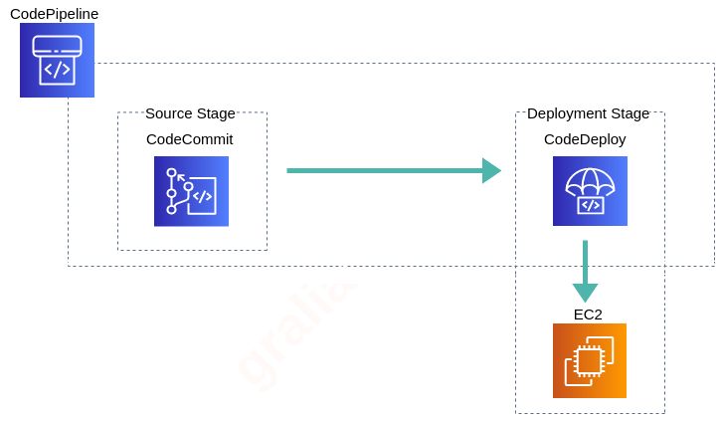
CodePipeline Service
Components
  CodeCommit: storing code (similar to GitHub)
  CodeBuild: build & testing service in CICD pipelines
  CodeDeploy: deploy the packaged code into EC2 and AWS Lambda

Slide 27
CodePipeline Service
Demo
  https://www.youtube.com/watch?v=KCcoQ7GBra8
  https://www.youtube.com/watch?v=NCXzTgjUOQo

Slide 28
Assignment
  Self-practice

Slide 29
Summary
ECS is service that allows manage containers on AWS (Similar to Docker Swarm, Kubernetes)
You must provision & maintain EC2 instances / Fargate (Serverless)
Integrated with other AWS Services (ELB, Autoscaling, SQS, ...)
Usecases: microservices, batch job
Components
  Registry (ECR/Docker Hub)
  Image, Container,
  Instance: EC2 instance/External instance/Fargate

Slide 30
Summary
  Task Definition / Task / Scheduling Task
  Service: Autoscaling, ELB, Health check
  Cluster
EKS is service that allows manage kubernetes containers running on AWS, GCP, Azure…, Open-source
CodePipeline
  Allows deploy and release applications continuously and automatically
  Components: CodeCommit, CodeBuild, CodeDeploy

Slide 31
Q & A
Copyright © VTI Academy All Rights Reserved

